Slide 1
Game Information Design
Wodtke
cs247

Slide 2
Values
Embedded in everything

Slide 3
Distributed Rules

Slide 4
Save Working Memory for strategy

Slide 5
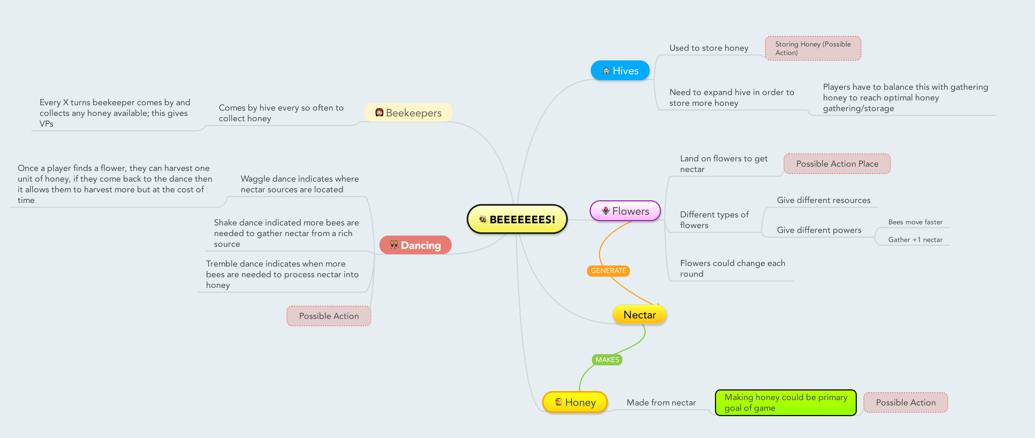
Design Prep
Write down all the information the player needs to know
Procedures
Rules
Resources

Slide 6
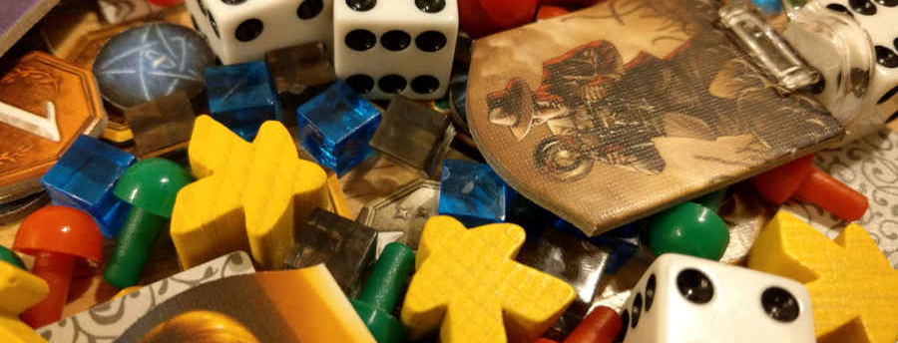
Design Prep
2. Write down all the places that information could go
Board
Player board
Cards
Tokens
More?

Slide 7
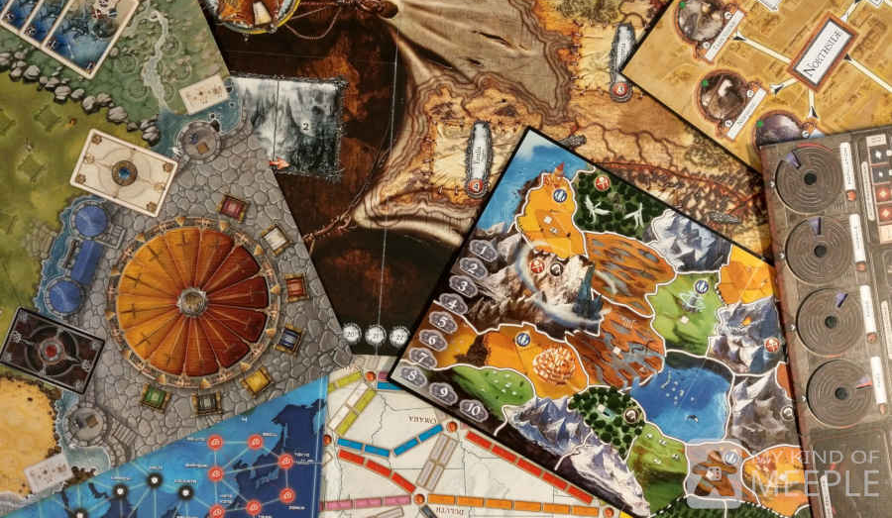
Boards
Size
How many
Mats (see pokemon, etc)
Notes:
https://mykindofmeeple.com/what-are-board-game-boards-made-of/

Slide 8
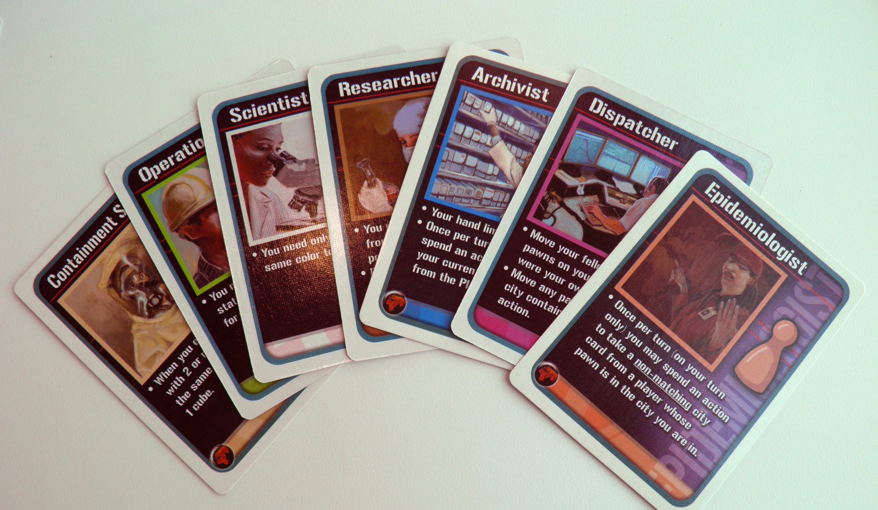
Cards
Size
Space use
Hidden information

Slide 9
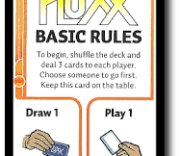
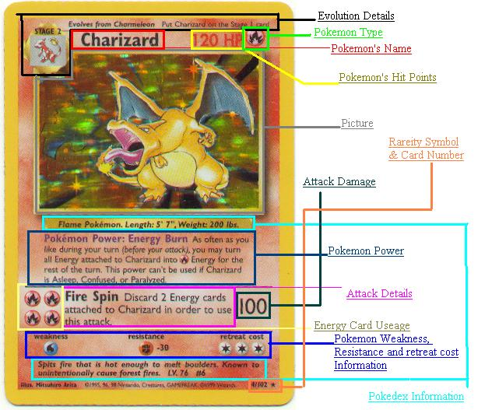
Cards should hold information
Value
Use
Weaknesses
Compatibility
etc
Notes:
Not the brain

Slide 11
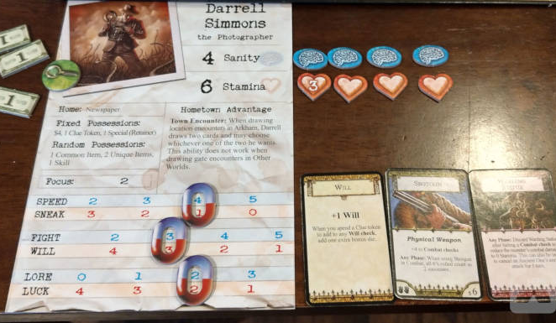
Notations
Character sheets
Scorepads
Answers (for simultaneous revels)
More?
Notes:
https://mykindofmeeple.com/board-game-pieces-names-examples-uses/

Slide 12
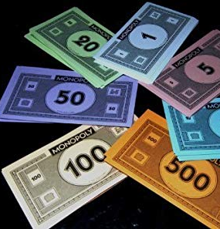
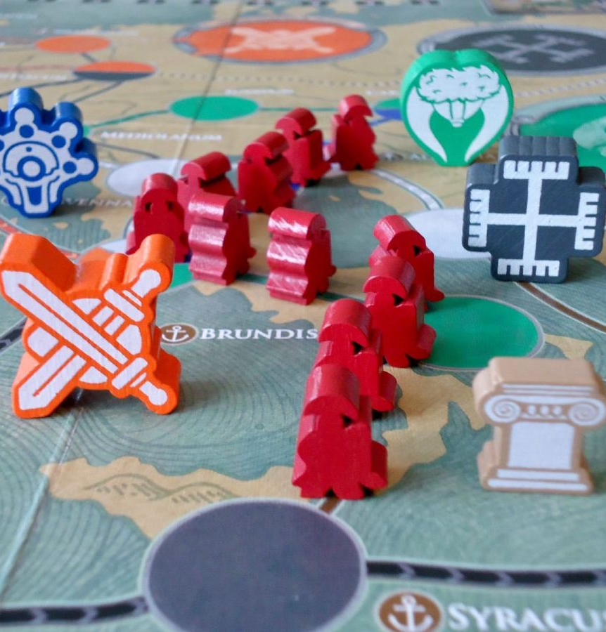
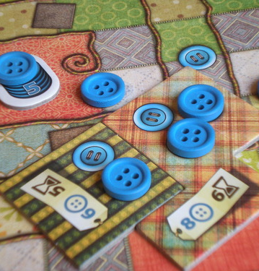
Chips/Tokens/Chits
Resource tracking | Reinforce theme

Slide 13
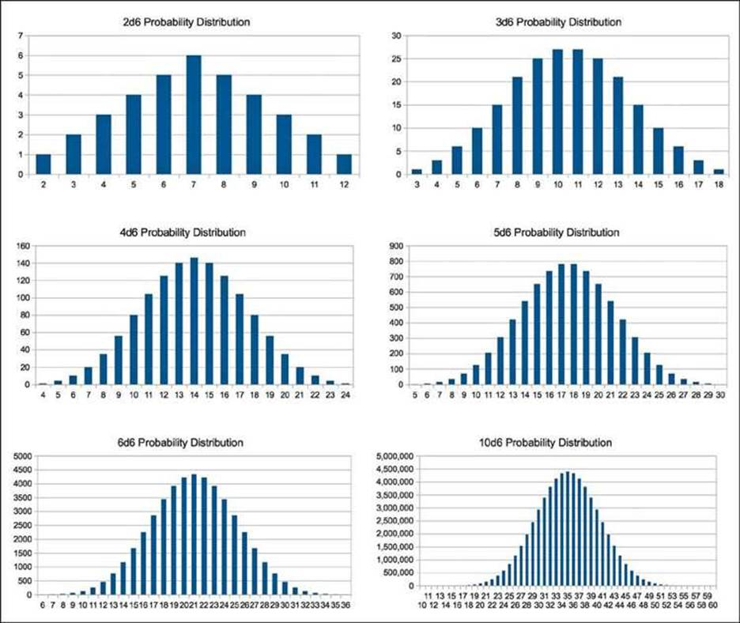
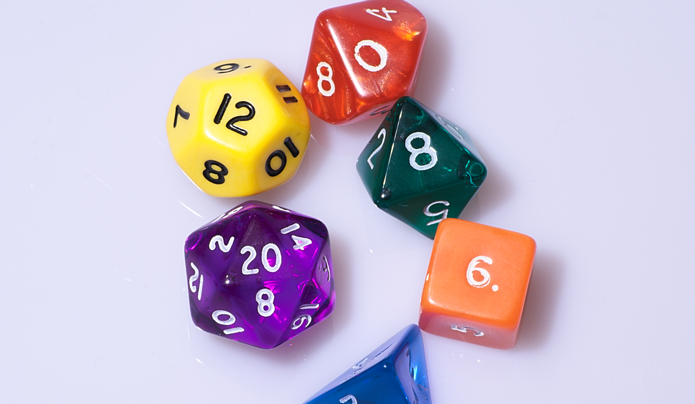
Dice
Probability

Slide 14
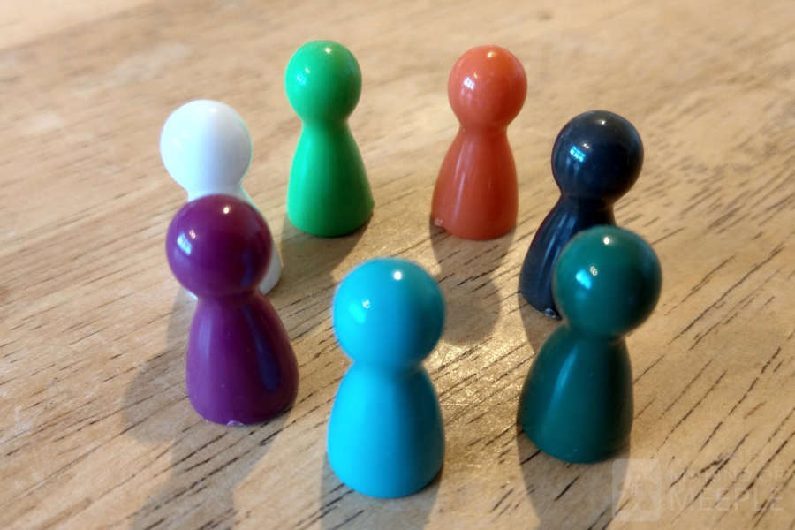
Markers/Pawns
Represent player or player’s representative

Slide 15
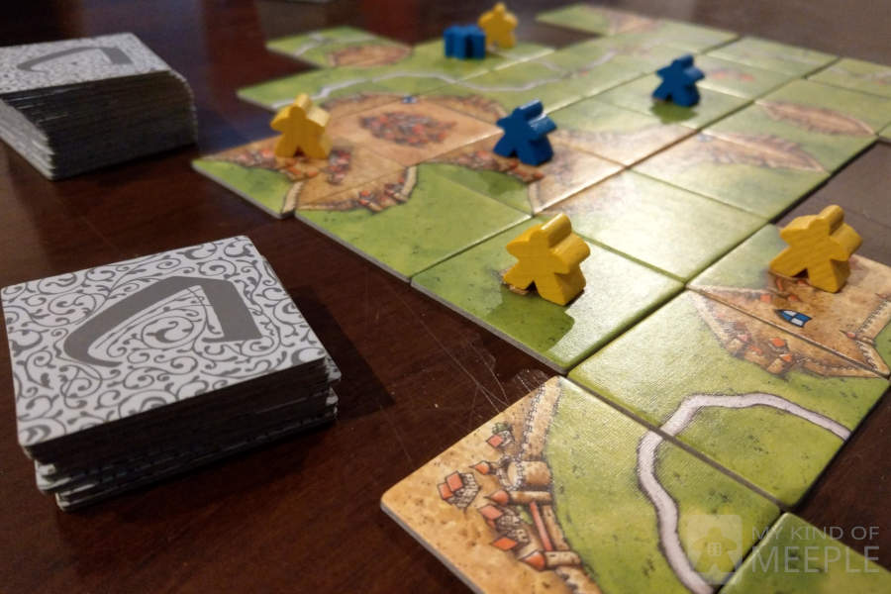
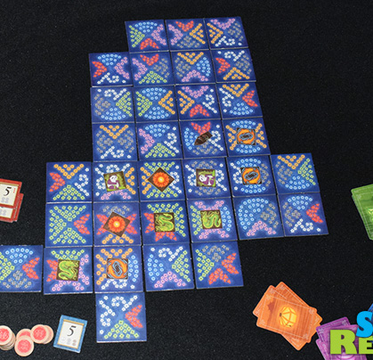
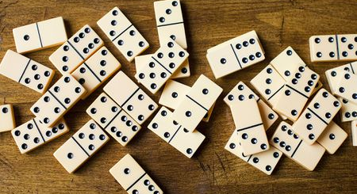
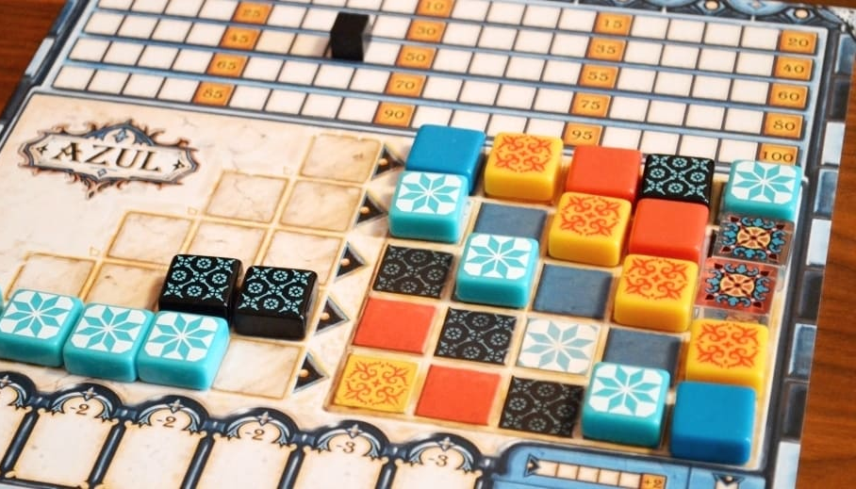
Tiles
On a board, or self-creating board
Meaningful relationships between sides

Slide 16
Timer

Slide 17
Designing the game
3. Place information wisely
Remember context
Multiple channels of information (color, icons, words)

Slide 18
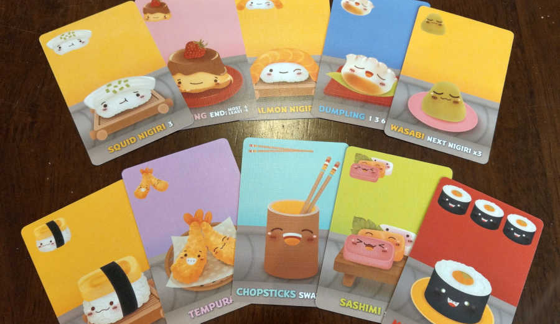
Design Strategies
Size
Color
Contrast
Repetition
Alignment
Proximity
Direction
Density and Whitespace

Slide 19
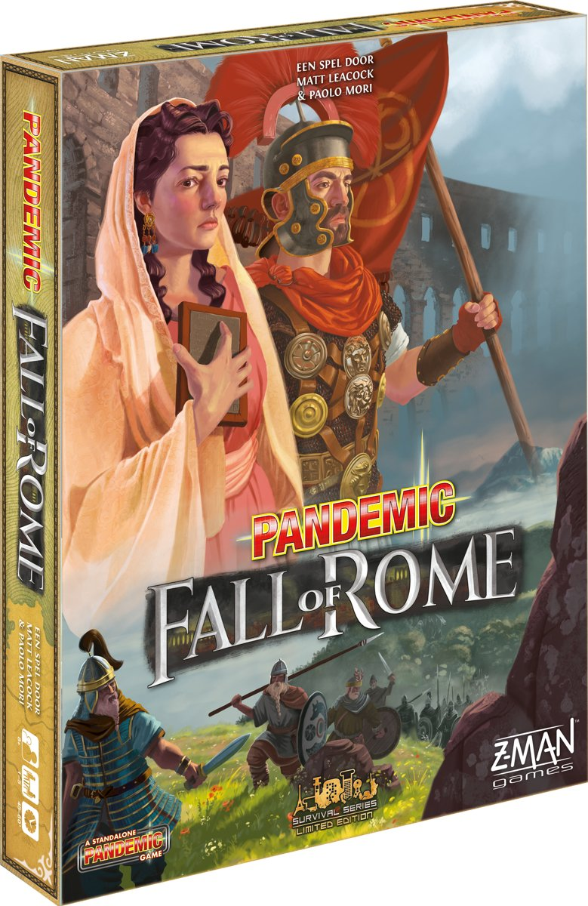
Fall of Rome
Iteration is key!

Slide 22
Eburacum
Londinium
colonia
LUtetia
magontiacum
You Co-designer
taNais
iuvanum
lugduinum
Carmuntum
Asturia
burdigalA
mediolanum
aquileia
Tyras
Chersonesus Taurica
Dioscurias
Numantia
massilia
GENUA
Ravenna
Olisipo
narona
Nicopolis
Narbo
aleria
roma
Sinope
Corduba
Brindisium
apolLonia
Costantinopolis
nova cartago
caralis
Pergamum
Melitene
Tingius
cartago
Icomion
Tarsus
cartenna
Syracusae
Athenae
Palmyra
Damascus
leptis maior
Cyrene
Alexandria
Jerusalem
Barbarians are the threat (not disease)
Barbarians migrate (they don’t just pop up everywhere)
Players battle using legions to remove barbarians
Heliopolis
Thebae

Slide 24
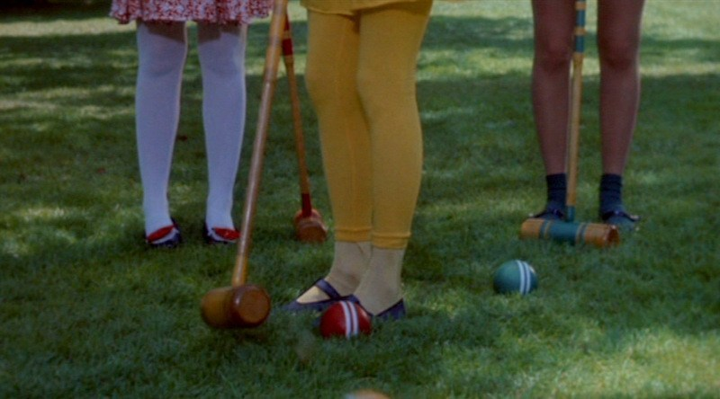
Color matters!
Don’t make yourself design without it.

Slide 25
Notes:
Thx to Matt Leacock

Slide 45
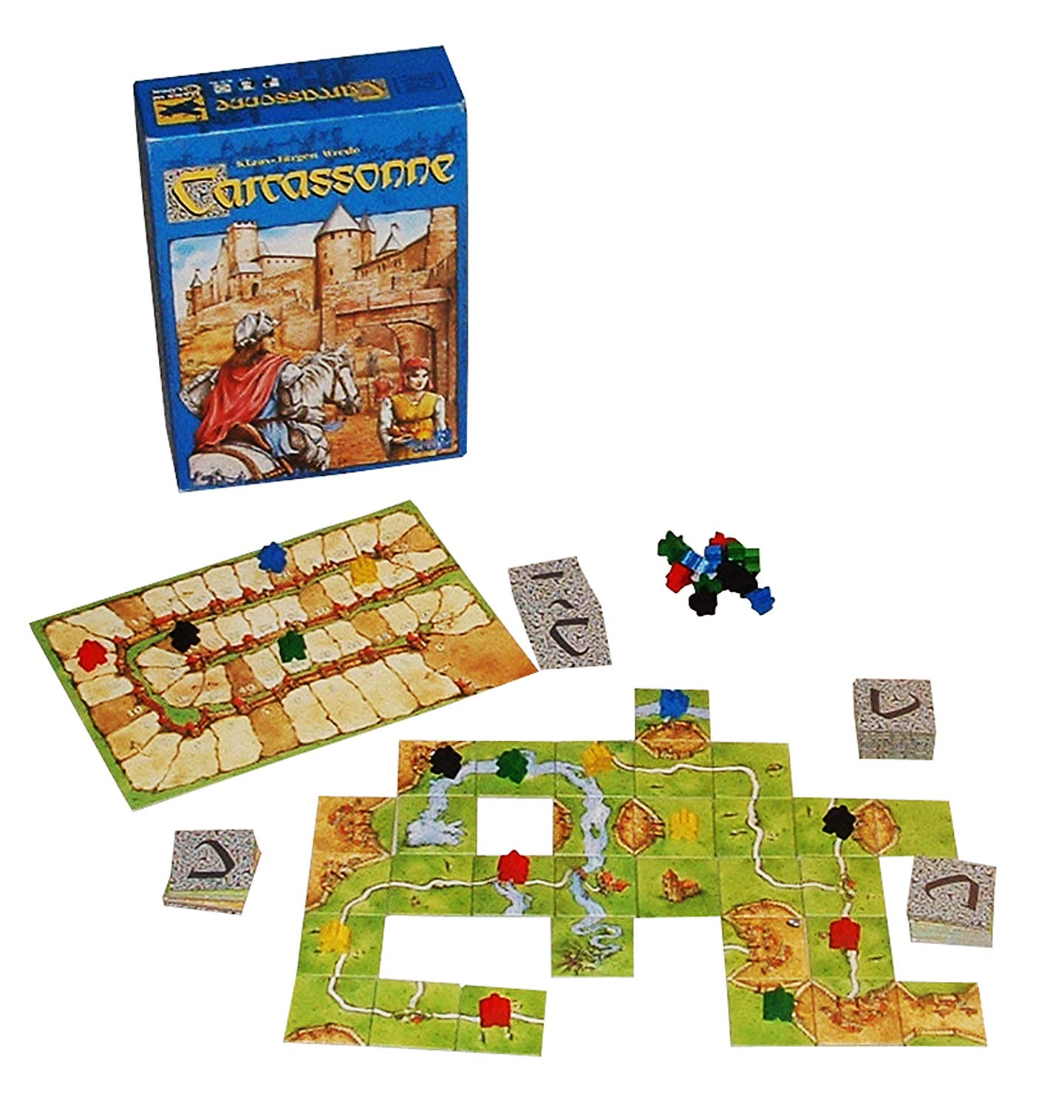
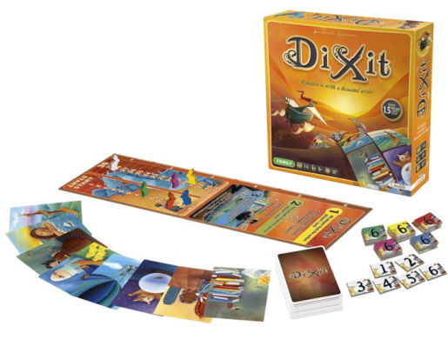
Player progress boards

Slide 46
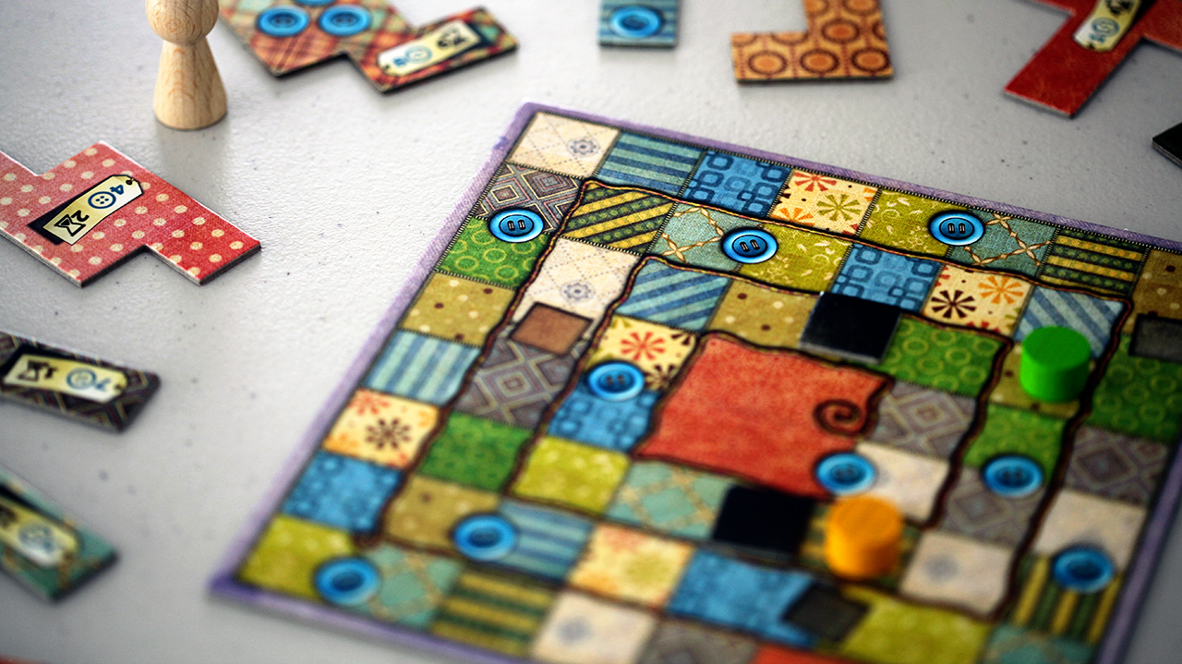
Pieces can hold place
Notes:
patchwork

Slide 47
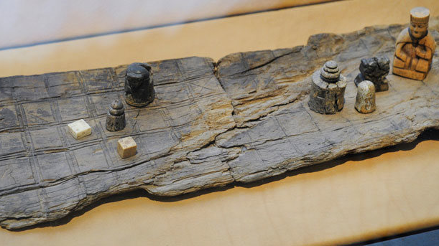
Games should invoke a mood

Slide 48
Q&A
More resources
https://www.gdcvault.com/play/1024914/Board-Game-Design-Day-Cardboard

